Slide 1



OWASP SAMM2 Training – Your Dynamic Software Security Journey
OWASP - ISACA Helsinki chapter
Wednesday, October 23, 2019

Slide 2


Slide 3



Bart?
Bart De Win, Ph.D.
20+ years experience in secure software development
Belgian OWASP chapter co-leader
OWASP SAMM contributor, evangelist and co-leader
Author of >60 publications
Director & security consultant @PwC BE
Bart.de.win@pwc.com

Slide 4

Sebastien Deleersnyder
CEO Toreon
Belgian OWASP chapter founder
SAMM project co-leader
Subscribe to our Threat Modeling Insider newsletter
Guest articles, curated articles, white papers, tips …
http://eepurl.com/ghAr8b

Slide 5
About you?
SAMM experience?
Role?
Specific expectations?

Slide 6
Chatham House Rule?
When a meeting, or part thereof, is held under the Chatham House Rule, participants are free to use the information received, but neither the identity nor the affiliation of the speaker(s), nor that of any other participant, may be revealed.
Notes:
https://www.chathamhouse.org/chatham-house-rule
It allows people to speak as individuals, and to express views that may not be those of their organizations, and therefore it encourages free discussion. People usually feel more relaxed if they don't have to worry about their reputation or the implications if they are publicly quoted.

Slide 7
This training ?
How to apply OWASP SAMM in practice
Looking into different parts from a practical perspective
Based on the case of your own company
Discussing some of the challenges that you might face
Open interaction session
SAMM2 – WIP

Slide 8
Timing
0900 – 1200:
Introduction to SDLC and OWASP SAMM
Applying OWASP SAMM:
Methodology
Assessment Governance
Assessment Design
Assessment Implementation
1200 – 1300: Lunch
1300 – 1400:
Assessment Verification
Assessment Operations
Setting Improvement Targets
1400 – 1430: Break (coffee / tea ja small sweet)
1430 – 1600:
OWASP SAMM Tools
OWASP SAMM Best Practices

Slide 9
Preparation
Get the OWASP SAMM2 Toolbox at:
https://github.com/OWASP/samm/tree/master/Supporting%20Resources/v2.0/toolbox/

Slide 10
Today’s Agenda
Introduction to SDLC and OWASP SAMM
Applying OWASP SAMM
Methodology
Assessment Governance
Assessment Design
Assessment Implementation
Assessment Verification
Assessment Operations
Setting Improvement Targets
OWASP SAMM Tools
OWASP SAMM Best Practices

Slide 11
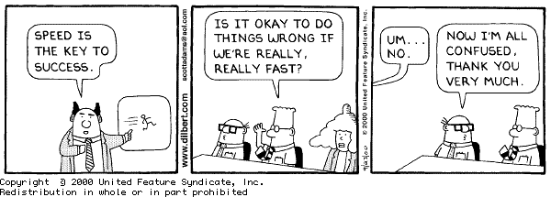
Application Security Problem
75% of vulnerabilities are application related
Quality (ISO 25010)
Cost
Speed of Delivery
Software complexity
Technology stacks
Requirements?
Mobile
Connected
Multi-platform
Cloud
Responsive Design

Slide 12
“Build in” software assurance
proactive
reactive
security
requirements /
threat modeling
coding guidelines code reviews static test tools
security testing dynamic test
tools
vulnerability
scanning -
WAF
Design
Build
Test
Production
Secure Development Lifecycle
(SAMM)
● 12 

Slide 13
Application Security during Software Development
Analyse
Design
Implement
Test
Deploy
Maintain

Slide 14
The State-of-Practice in Secure Software Development
Problematic, since:
Focus on bugs, not flaws
Penetration can cause major harm
Not cost efficient
No security assurance
All bugs found ?
Bug fix fixes all occurences ? (also future ?)
Bug fix might introduce new security vulnerabilities
Analyse
Design
Implement
Test
Deploy
Maintain
(Arch review)
Pentest
Penetrate & Patch

Slide 15
SDLC ?
Enterprise-wide software security improvement program
Strategic approach to assure software quality
Goal is to increase systematicity
Focus on security functionality and security hygiene
Analyse
Design
Implement
Test
Deploy
Maintain
SDLC

Slide 16
SDLC Cornerstones
Process
Activities
Control Gates
Knowledge
Standards & Guidelines
Tools & Components
Deliverables
Transfer methods
People
Roles & Responsibilities
Compliance
Development support
Assessment tools
Management tools
Risk
Training
SecAppDev 2013
Notes:
16

Slide 17
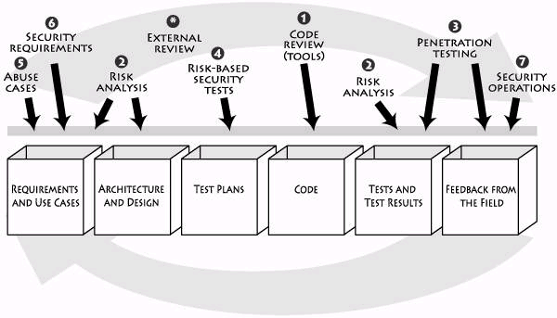
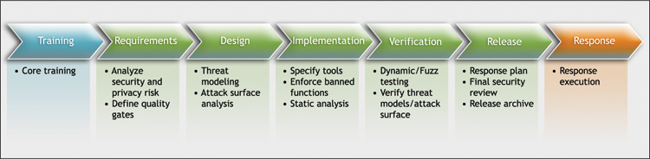

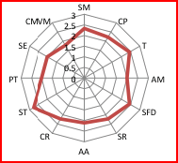



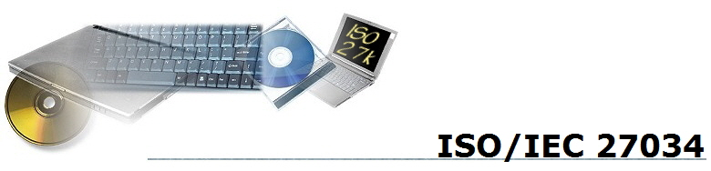
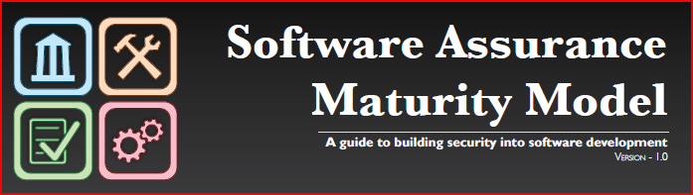
SDLC-related initiatives
TouchPoints
Microsoft SDL
SP800-64
CLASP
BSIMM
SSE-CMM
TSP-Secure
GASSP
SAMM

Slide 18
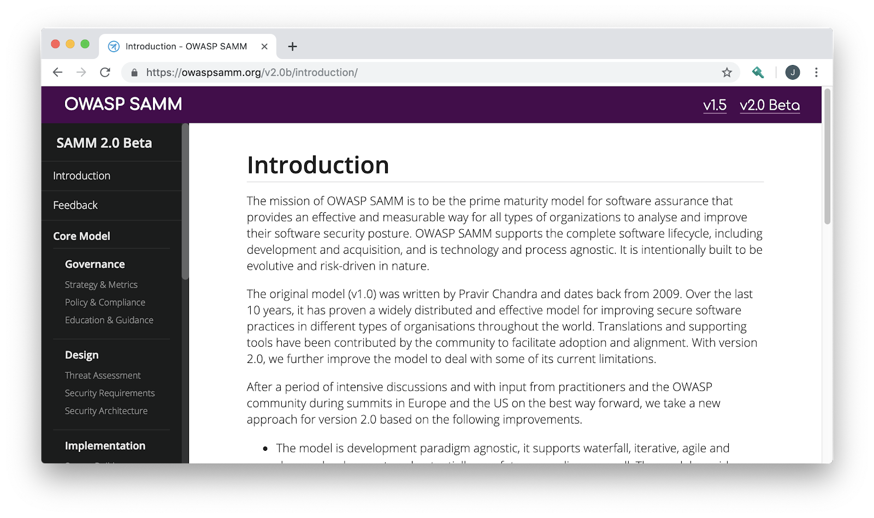
Why a Maturity Model ?
An organization’s behavior changes slowly over time
Changes must be iterative while working toward long-term goals
There is no single recipe that works for all organizations
A solution must enable risk-based choices tailored to the organization
Guidance related to security activities must be prescriptive
A solution must provide enough details for non-security-people
Overall, must be simple, well-defined, and measurable
OWASP Software Assurance Maturity Model (SAMM)

Slide 19
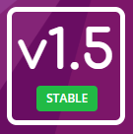
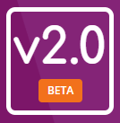
OWASP SAMM
https://owaspsamm.org/

Slide 20
Project History
March 2016
February 2017
BETA – Jan 2019
OWASP SAMM 1.1
OWASP SAMM 1.5
OWASP SAMM 2.0
OpenSAMM 1.0
March 2009
OpenSAMM 1.1
Notes:
Version 1.0 of OpenSAMM was originally created through the OpenSAMM Project led by Pravir Chandra (chandra@owasp.org), an independent software security consultant. Creation of the first draft was made possible through funding from Fortify Software, Inc.
After a number of years, a small group got together at OWASP and worked together to breathe some life into SAMM as an OWASP project.
Version 1.1 of SAMM expanded and restructured its predecessor into four complementary resources:
Core Document: that describes the core SAMM model
How-To Guide: that explains how to apply the model
Quick Start Guide: to help accelerate learning and adoption
Toolbox (spreadsheet): that provides simple automation for data collection, metrics, and graphs.
The project team released v1.5 of SAMM in February 2017, which incorporated a refinement of the scoring model, to provide more granularity to the scoring in an assessment. Now an organization will get credit for all the related work done in a practice rather than having the base number held at the highest completed maturity level.
The updated scoring model was designed to help SAMM assessors and organizations avoid the awkward discussion on whether to mark an answer yes or no when it is honestly something in between, and to show incremental improvements.
The project team began working in earnest on Version 2.0 in late 2017, and officially released the Beta draft for comment at the end of January. In this update, we’ve expanded the breadth of business functions and practices covered, and are working through improvements to the the scoring model to include additional factors.

Slide 21
Key changes in SAMM v2.0
SAMM v1.5
SAMM v2.0
Four Business Functions - Governance, Construction, Verification, Operations
12 Security Practices
Very little, if any, prescriptive guidance for build and deploy domains
Maturity level activities could be orphaned, and sometimes unrelated to each other
Maturity level activities not in order of increasing difficulty, cost of implementation
Coverage based measurement
Five Business Functions - Governance, Design, Implementation, Verification, Operations
15 Security Practices
New Business Function "Implementation" to accommodate guidance related to build and deploy domains
Maturity level activities are aligned and linked per Stream. Each stream has a clear Objective
Maturity level activities designed in order of increasing difficulty, implementation cost
Coverage & Quality based measurement
Also includes supporting infrastructure

Slide 22

OWASP SAMM 101

Slide 23
SAMM Business Functions
Start with the core activities tied to any organization performing software development
Named generically, but should resonate with any development stakeholder
Governance
Design
Implementation
Verification
Operations

Slide 24
SAMM Security Practices
From each of the Business Functions, 3 Security Practices are defined
The Security Practices cover all areas relevant to software security assurance
Each one is a ‘silo’ for improvement
Governance
Strategy & Metrics
Policy & Compliance
Design
Threat Assessment
Security Requirements
Implementation
Secure Build
Education & Guidance
Security Architecture
Secure Deployment
Defect Management
Verification
Architecture Assessment
Requirements Testing
Security Testing
Operations
Incident Management
Environment Management
Operational Management

Slide 25
SAMM v2.0 Core Framework
Governance
Strategy & Metrics | Create and Promote | Measure and Improve
Policy & Compliance | Policy and Standards | Compliance Management
Education & Guidance | Training and Awareness | Organization and Culture
Design
Threat Assessment | Application Risk Profile | Threat Modeling
Security Requirements | Software Requirements | Supplier Security
Secure Architecture | Architecture Design | Technology Management
Implementation
Secure Build | Build Process | Software Dependencies
Secure Deployment | Deployment Process | Secret Management
Defect Management | Defect Tracking (Flaws/Bugs/Process) | Metrics and Feedback/Learning
Verification
Architecture Assessment | Architecture Validation | Architecture Compliance
Requirements Testing | Control Verification | Misuse/Abuse Testing
Security Testing | Scalable Baseline | Deep Understanding
Operations
Incident Management | Incident Detection | Incident Response
Environment Management | Configuration Hardening | Patching and Updating
Operational Management | Data Protection | System decommissioning / Legacy management

Slide 26
Under each Security Practice
Three successive Objectives under each Practice define how it can be improved over time
This establishes a notion of a Level at which an organization fulfills a given Practice
The three Levels for a Practice generally correspond to:
(0: Implicit starting point with the Practice unfulfilled)
1: Initial understanding and ad hoc provision of the Practice
2: Increase efficiency and/or effectiveness of the Practice
3: Comprehensive mastery of the Practice at scale

Slide 27
Activity Streams & Maturity Levels
Example: Verification - Requirements Testing
Streams
 | A: Control Verification | B: Misuse/Abuse Testing
Maturity 1 - Opportunistically find basic vulnerabilities and other security issues. | Test for standard security controls | Perform security fuzzing testing
Maturity 2 - Perform implementation review to discover application-specific risks against the security requirements. | Derive test cases from known security requirements | Create and test abuse cases and business logic flaw test
Maturity 3 - Maintain the application security level after bug fixes, changes or during maintenance | Perform regression testing (with security unit tests) | Denial of service and security stress testing
Maturity
Activities
This security practice focuses on creating and integrating both positive (Control Verification) and negative (Misuse/Abuse Testing) security tests based on requirements (user stories)..

Slide 28
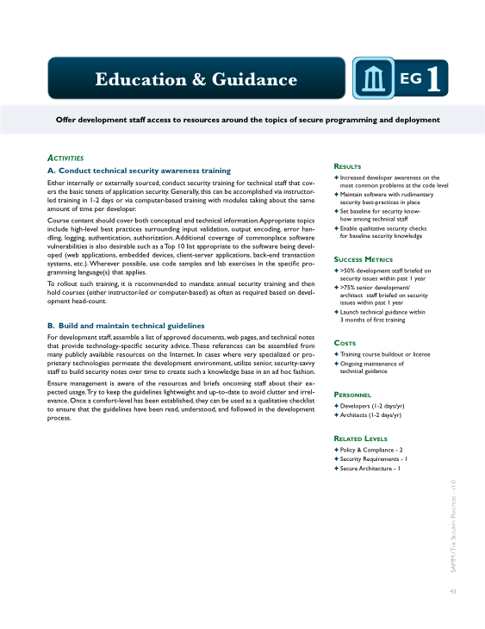
Per Level, SAMM defines...
Objective
Activities
Results
Success Metrics
Costs
Personnel
Related Levels

Slide 29

Applying the model

Slide 30
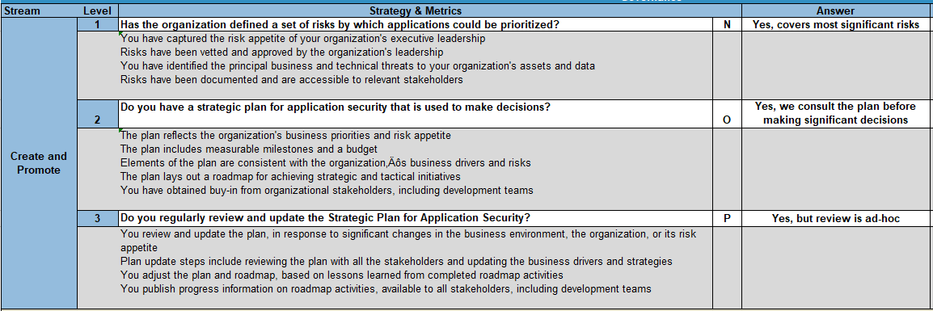
Conducting assessments
SAMM includes assessment worksheets for each Security Practice

Slide 31
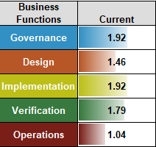
Assessment process
Assessing activities along two axes:
Coverage, by means of questions
Quality, by means of mandatory criteria

Slide 32
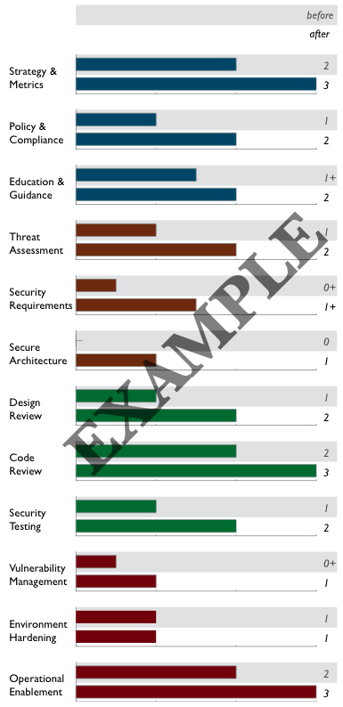
Creating Scorecards
Gap analysis
Capturing scores from detailed assessments versus expected performance levels
Demonstrating improvement
Capturing scores from before and after an iteration of assurance program build-out
Ongoing measurement
Capturing scores over consistent time frames for an assurance program that is already in place

Slide 33
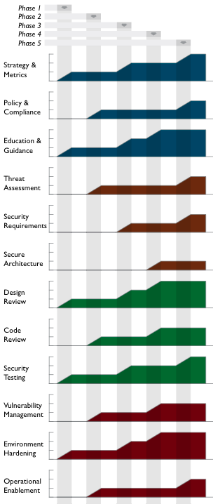
Roadmap templates
To make the “building blocks” usable, SAMM defines Roadmaps templates for typical kinds of organizations
Independent Software Vendors
Online Service Providers
Financial Services Organizations
Government Organizations
Organization types chosen because
They represent common use-cases
Each organization has variations in typical software-induced risk
Optimal creation of an assurance program is different for each

Slide 34
Today’s Agenda
Introduction to SDLC and OWASP SAMM
Applying OWASP SAMM
Methodology
Assessment Governance
Assessment Construction
Assessment Verification
Assessment Operations
Setting Improvement Targets
OWASP SAMM Tools
OWASP SAMM Best Practices

Slide 35
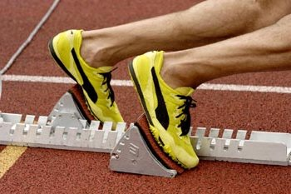
Before you begin
Organizational Context
Realistic Goals ?
Scope ?
Constraints (budget, timing, resources)
Affinity with a particular model ?

Slide 36
What’s your Company Maturity ?
In terms of IT strategy and application landscape
In terms of software Development practices
Analysis, Design, Implementation, Testing, Release, Maintenance
Structured vs. ad-hoc development
In terms of ITSM practices
Configuration, Change, Release, Vulnerability -Mngt.
Company
Maturity
≈
Feasibility
SDLC
Program

Slide 37

Complicating factors, anyone ?
Different development teams
Different technology stacks
Business-IT alignment issues
Outsourced development
...

Slide 38
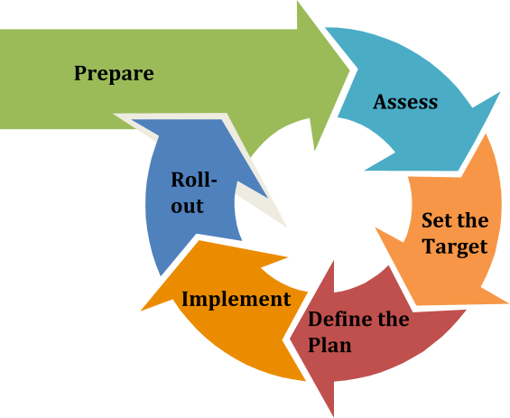
Typical Approach

Slide 39
Prepare
Purpose
Ensure a proper start of the project
Activities
Define the scope (uniform unit(s))
Identify stakeholders
Spread the word

Slide 40
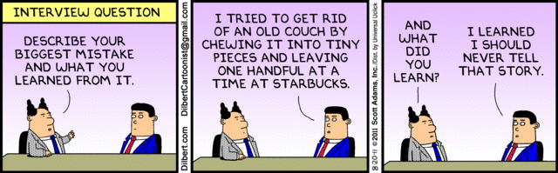
Assess
Purpose
Identify and understand the maturity of the 15 practices for the chosen scope
Activities
Evaluate current practices
Determine maturity level

Slide 41

Set The Target
Purpose
Develop a target score to guide you in future improvements
Activities
Define the target
Estimate overall impact

Slide 42

Define the plan
Purpose
Define or update the plan to take you to the next level
Activities
Determine change schedule
Develop/update the roadmap plan

Slide 43
Implement
Objective
Work the plan
Activities
Implement activities

Slide 44
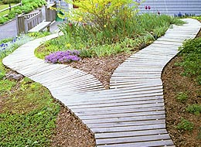
Roll-out
Objective
Ensure improvements are available and effectively used
Activities
Evangelize improvements
Measure effectiveness

Slide 45
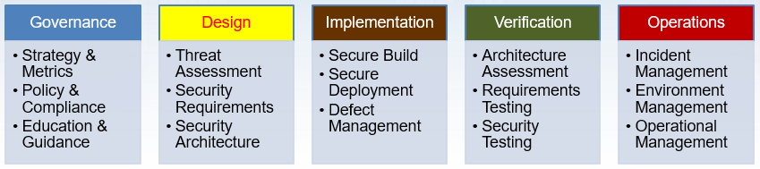
Governance
Business Function

Slide 46
Strategy & Metrics
Goal is to establish a software assurance framework within an organisation
Driver for all other OWASP SAMM practices
Characteristics:
Measurable
Aligned with business risk
Continuous improvement

Slide 47
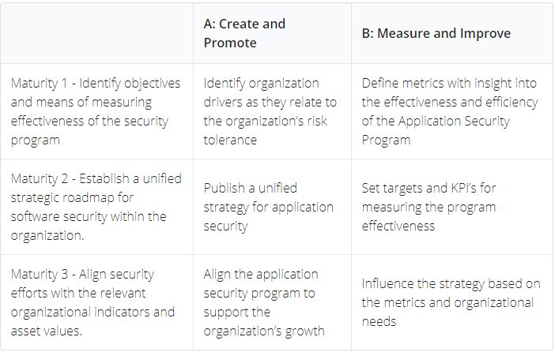
Strategy & Metrics

Slide 48

Policy & Compliance
Goal is to understand and adhere to legal and regulatory requirements
Internal standards as well as 3rd party requirements
Both Security and Privacy are important
Technical standards become more important
They are an important driver for software security requirements
Often a very informal practice in organisations

Slide 49
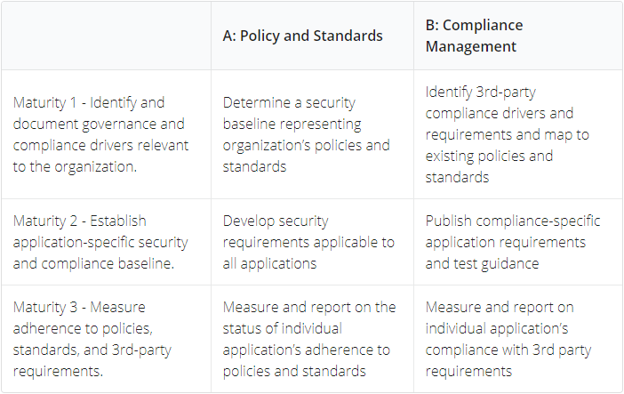
Policy & Compliance

Slide 50
Education & Guidance
Goal is to disseminate security-oriented information to all stakeholders involved in the software development lifecycle
Security to be integrated in organisation training curriculum
A once-of effort is not sufficient
Teach a fisherman to fish
Work on the organisational habits via security culture
Important element of a successful software assurance project

Slide 51
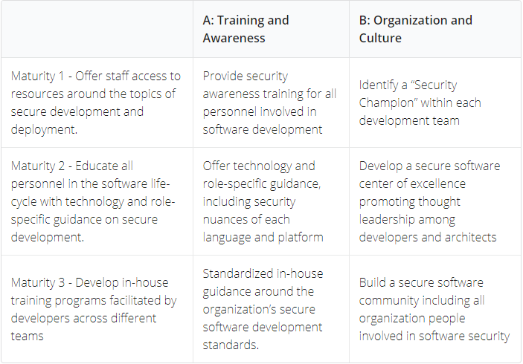
Education & Guidance

Slide 52

Assessment Exercise
Use OWASP SAMM to evaluate the development practices in your own company
Focus on Governance Business Function
Applicable to both Waterfall and Agile models
Using questionnaires (toolbox)

Slide 53
Assessment wrap-up
What’s your company’s score ?
What’s the average scores for the group ?
Any odd ratings ?

Slide 54
Design
Business Function

Slide 55
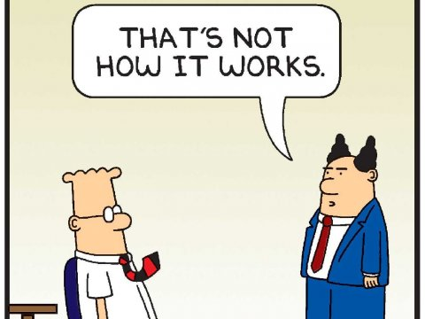
Threat Assessment
Analyze the risks of the application
from a business perspective, via risk profiles
from a technical perspective, via threat modeling
Threat modeling is where “the magic” kicks in
Your imagination is the limit

Slide 56
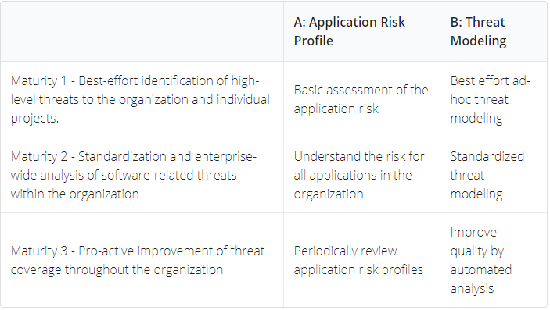
Threat Assessment

Slide 57
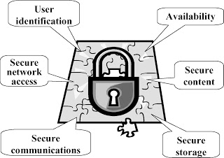
Security Requirements
Goal is to make security specification more explicit
Turn security into a positively-spaced problem
Source of security requirements
Compliance
Standard
Functionality
Quality
Requirements should be specified in a S.M.A.R.T. way
Also look into how suppliers are dealing with software security

Slide 58
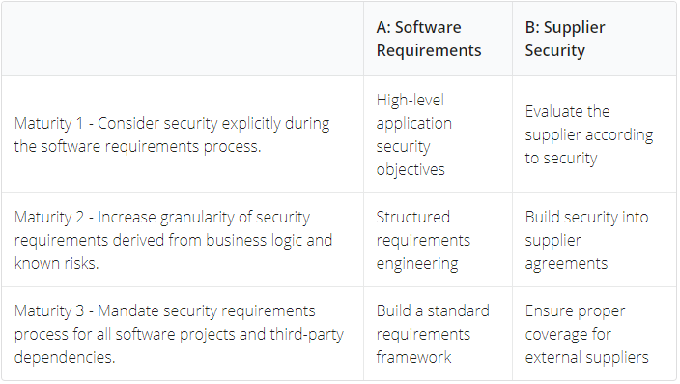
Security Requirements

Slide 59
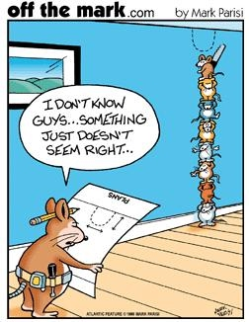
Secure Architecture
Secure Architecture is a key practice for security. Poor decisions at this step can have major impact, and are often difficult (or costly) to fix.
Software Architecture components
Ensure that the architecture contains proper elements to meet the security requirements
Supporting Technology
Verify that development stacks, deployment tools and other supporting technology are in-line with security expectations

Slide 60
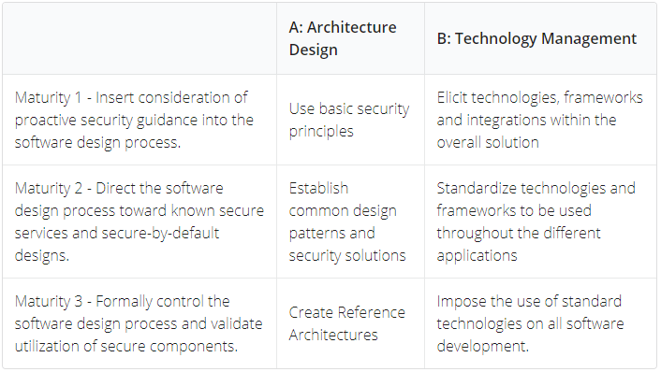
Secure Architecture

Slide 61
Assessment Exercise
Use OWASP SAMM to evaluate the development practices in your own company
Focus on Design Business Function
Applicable to both Waterfall and Agile models
Using questionnaires (toolbox)

Slide 62
Assessment wrap-up
What’s your company’s score ?
What’s the average scores for the group ?
Any odd ratings ?

Slide 63
Implementation
Business Function

Slide 64

Secure Build
Secure build focuses on using a reliable production process in order to generate secure software artefacts and to avoid issues being introduced during the process
An important part is the build process itself, where the goal is
consistent and repeatable
automated
A second part focuses on software dependencies or 3rd party libraries, aka supply chain security.

Slide 65
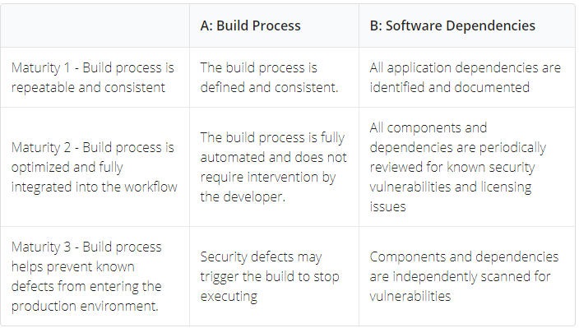
Secure Build

Slide 66
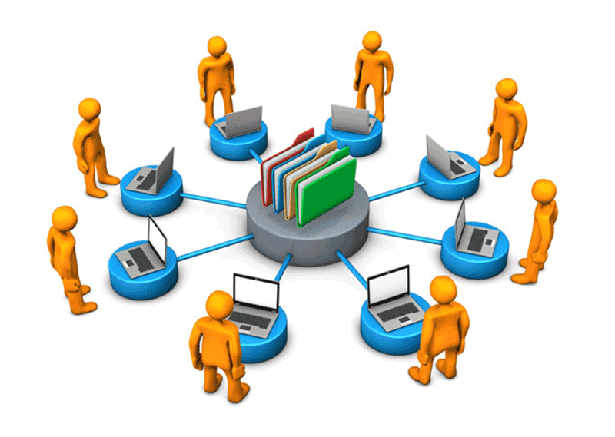
Secure Deployment
One of the final stages in delivering secure software is ensuring the security and integrity of developed applications are not compromised during their deployment.
In the deployment process, appropriate protection can a repeatable deployment process, separation of duties, etc.
All secrets required for the software to run must be properly protected for deployment and during execution. Tools such as password vaults can help to achieve this.

Slide 67
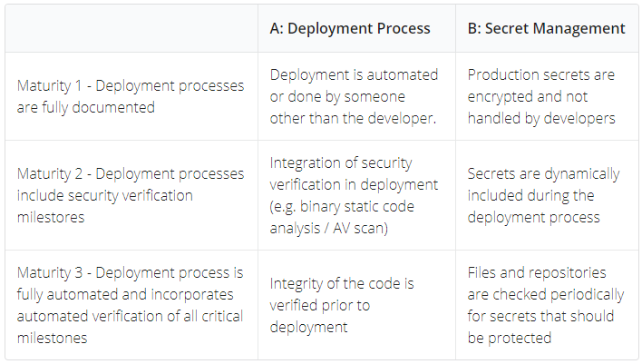
Secure Deployment

Slide 68
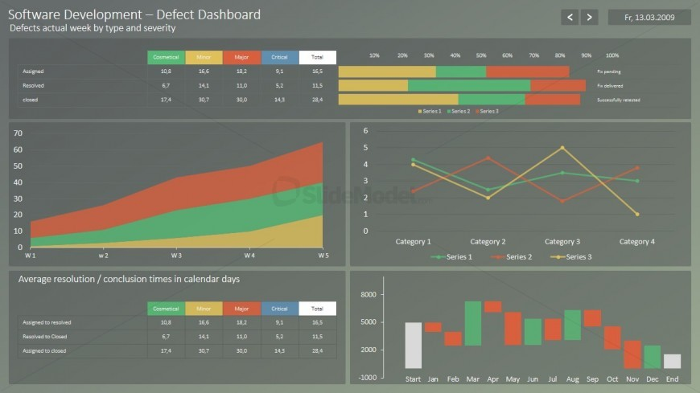
Defect Management
The Defect Management practice focuses on collecting, recording, and analysing software security defects and enriching them with information to drive metrics-based decisions.
It is a central funnel for all defects identified in other security practices.
A defect tracking solution helps the organization to keep track of identified problems, and to manage them in a controlled manner.
Analysis of defects supported by metrics can help to increase awareness and guide improvement programs in the organization.

Slide 69
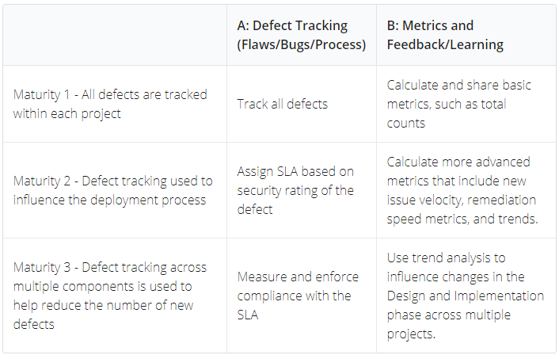
Defect Management

Slide 70
Assessment Exercise
Use OWASP SAMM to evaluate the development practices in your own company
Focus on Implementation Business Functions
Applicable to both Waterfall and Agile models
Using questionnaires (toolbox)

Slide 71
Assessment wrap-up
What’s your company’s score ?
What’s the average scores for the group ?
Any odd ratings ?

Slide 72
Verification
Business Function

Slide 73
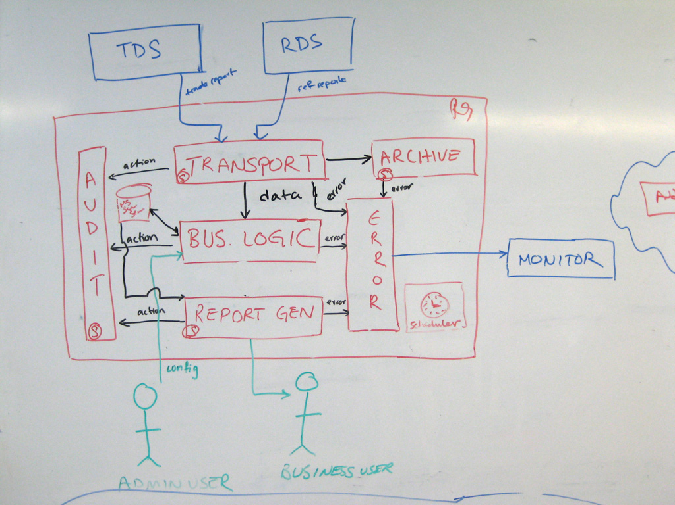
Architecture Assessment
Verify whether the meets security and compliance requirements
Covers both software and supporting infrastructure
Rigorous inspection of data flows & security mechanisms

Slide 74
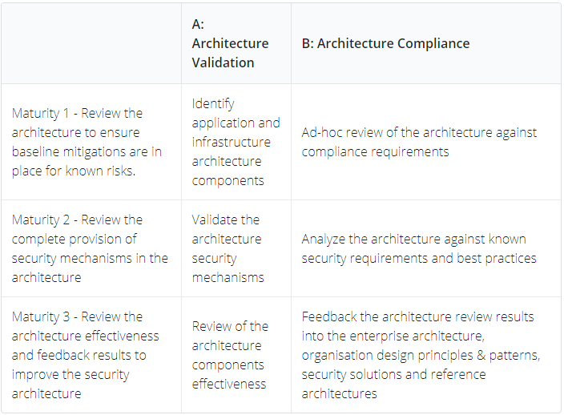
Architecture Assessment

Slide 75
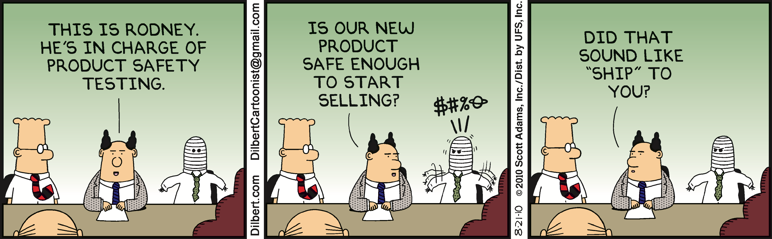
Requirements Testing
First perspective for testing: test the software according to the requirements
Conduct positive and negative security tests to verify that the software operates as specified.
From the known security requirements, identify and implement a set of security test cases to check the software for correct functionality.
Use abuse testing for an application to run concrete security tests that directly or indirectly exploit identified abuse scenarios.
Automate security testing (for each release) via security test automation and automated regression testing

Slide 76
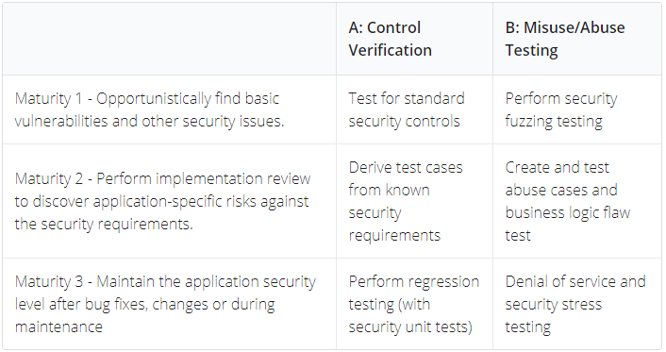
Requirements Testing

Slide 77
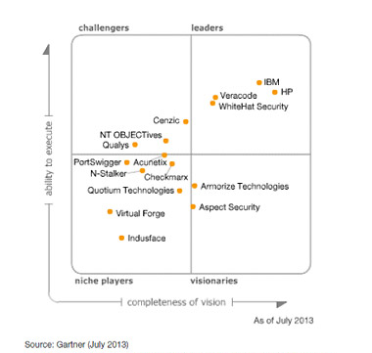
Security Testing
Second perspective for testing: test the software according to security best practices
This is where the typical SAST/DAST/IAST takes place
Manual testing can achieve more intelligent and intricate verification
Detected defects will require validation, risk analysis & recommendations to fix
 | Manual | Automated
Source Code
Dynamic behavior

Slide 78
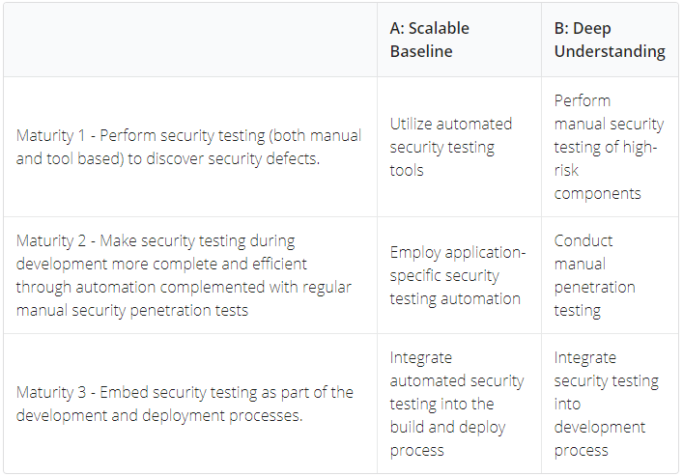
Security Testing

Slide 79
Assessment Exercise
Use OWASP SAMM to evaluate the development practices in your own company
Focus on Verification Business Functions
Applicable to both Waterfall and Agile models
Using questionnaires (toolbox)

Slide 80
Assessment wrap-up
What’s your company’s score ?
What’s the average scores for the group ?
Any odd ratings ?

Slide 81
Operations
Business Function

Slide 82

Incident Management
Prepare for WHEN, not IF!
Symptoms of malfunctioning SDLC
Examples of a security incidents:
successful DoS (Denial of Service) attack against a cloud application
application user accessing private data of another one by abusing a security vulnerability
attacker modifying the application source code
Have a capability in place to detect potential incidents
Make sure you can respond to detected incidents
Use vulnerability metrics and root-cause analysis to improve SDLC

Slide 83
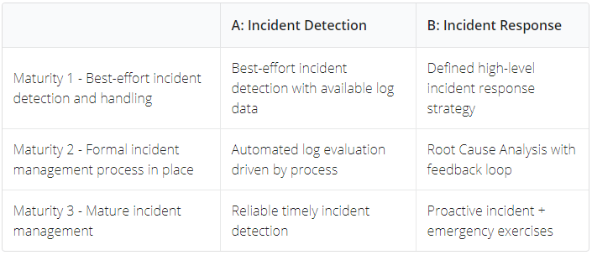
Incident Management

Slide 84

Environment Management
Application security is not over once the application becomes operational. New security features and patches are continuously released until the technology stack you’re using becomes obsolete.
Pro-active hardening of the different technology components in the software environment by activing security features and removing unnecessary ones.
Installing patches to ensure technology components can withstand known security attacks.
Consider virtual patching for temporary fixes

Slide 85
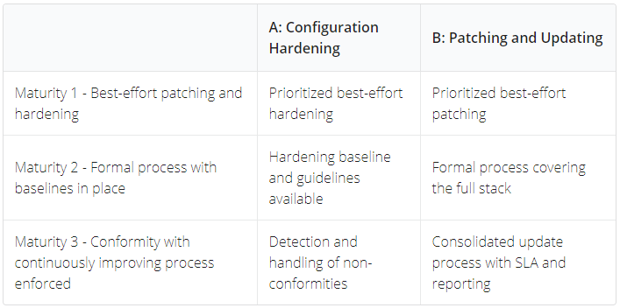
Environment Management

Slide 86
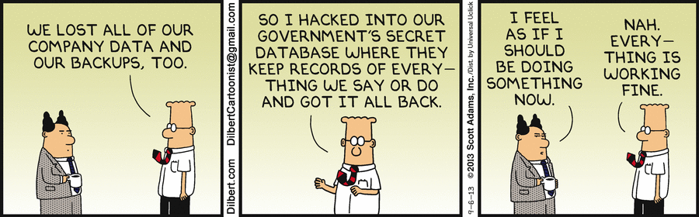
Operational Management
This practice focuses on operational support activities required to maintain security throughout the product lifecycle.
Data must be sufficiently protected in its different forms and environments to ensure a correct operation of the application
Legacy management ensures there are no loose ends, often forgotten, in the organisation which may form an easy target to attackers.

Slide 87
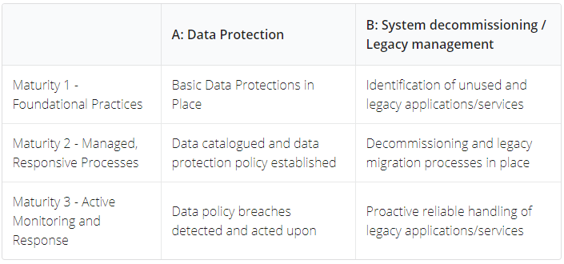
Operational Management

Slide 88
Assessment Exercise
Use OWASP SAMM to evaluate the development practices in your own company
Focus on Operations Business Functions
Applicable to both Waterfall and Agile models
Using questionnaires (toolbox)

Slide 89
Assessment wrap-up
What’s your company’s score ?
What’s the average scores for the group ?
Any odd ratings ?

Slide 90
Setting the Target/Roadmap
Roadmap templates can provide direction for targets
What type of company are you ?
Take into account the company’s risk appetite
Only include activities where you see added value for the company, even for lower levels
OWASP SAMM activities have dependencies – use them !
Think about links with other practices in the company
E.g., training, release management, …

Slide 91
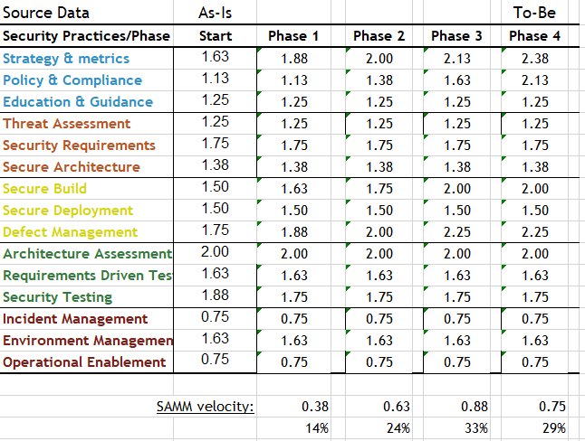
Staged Roadmap
Notes:
91

Slide 92
Improvement Exercise
Define a target for your company and the phased roadmap to get there
Focus on the most urgent/heavy-impact practices first
Decide where you want to put the focus for the coming 3 years
Try balancing the complexity and effort of the different step-ups

Slide 93
Conclusion Applying OWASP SAMM
Lightweight assessment of 15 security practices
Your thoughts:
Representative summary ?
New insights learned ?
Anything not covered ?
…

Slide 94
Today’s Agenda
Introduction to SDLC and OWASP SAMM
Applying OWASP SAMM
Methodology
Assessment Governance
Assessment Construction
Assessment Verification
Assessment Operations
Setting Improvement Targets
OWASP SAMM Tools
OWASP SAMM Best Practices

Slide 95
OWASP SAMM Tools
Translations of the OWASP SAMM model (Spanish, Japanese, German, Ukrainian, …)
Assessment questionnaire(s)
Roadmap chart template
Project plan template
OWASP SAMM-BSIMM mapping
Benchmark Project
Mappings to security standards
ISO/IEC 27034, PCI, …
OWASP SAMM Assessment Toolbox

Slide 96
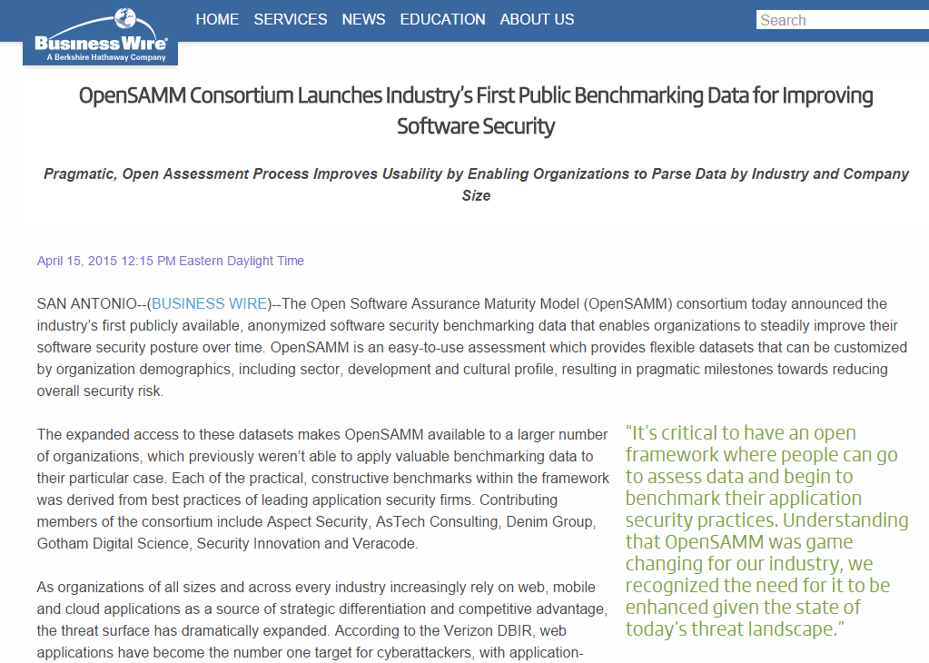
Benchmark Project

Slide 97
OWASP SAMM Benchmarking Overview
An open model for security benchmarking
Consortium of security companies working together
Confidentiality maintained between client & security company
Public data anonymized for benchmarking between teams, organizations

Slide 98
OWASP SAMM Benchmarking Benefits
Validate transformation plans
Supporting existing plans
Clients of various security companies can utilize platform
Find specific maturities in teams and organizations with varying granularity
Bring security maturity testing to the masses

Slide 99
150+ OWASP Projects
PROTECT
Tools: AntiSamy Java/:NET, Enterprise Security API (ESAPI), ModSecurity Core Rule Set Project
Docs: Development Guide, .NET, Ruby on Rails Security Guide, Secure Coding Practices - Quick Reference Guide
DETECT
Tools: JBroFuzz, Lice CD, WebScarab, Zed Attack Proxy
Docs: Application Security Verification Standard, Code Review Guide, Testing Guide, Top Ten Project
LIFE CYCLE
SAMM, WebGoat, Legal Project
https://www.owasp.org/index.php/Category:SAMM-Resources

Slide 100
Today’s Agenda
Introduction to SDLC and OWASP SAMM
Applying OWASP SAMM
Methodology
Assessment Governance
Assessment Construction
Assessment Verification
Assessment Operations
Setting Improvement Targets
OWASP SAMM Tools
OWASP SAMM Best Practices

Slide 101

The importance of a Business Case
If you want your company to improve, management buy-in is crucial
You will need a business case to convince them
Typical arguments:
Improved security quality
Better cost efficiency
Compliance
Risk management
Customer satisfaction
Reputation management

Slide 102
Entry Points
Pick the weak spots that can demonstrate short-term ROI
Typical examples
Awareness training
Coding Guidelines
External Pentesting
Success will help you in continuing your effort

Slide 103

Application categorization
Use this to rationalize security effort (according to the application risk)
Granularity !
Inter- Connectivity !

Slide 104

Communication & Support
Critical success factor !
Spreading the message – broad audience
Setup a secure applications portal !
Regular status updates towards management

Slide 105
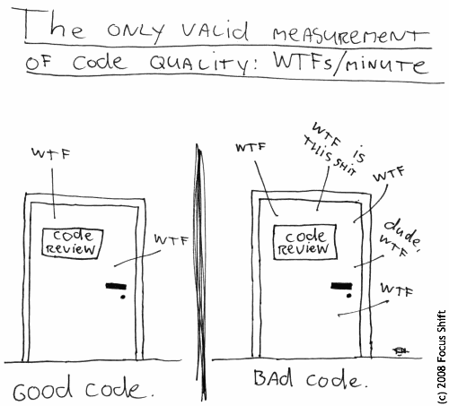
Monitoring & Metrics
Project vs. Enterprise dashboard
Manual vs. Automated data collection

Slide 106
Responsibilities
Core Security team
Support vs. Responsible role
Security Satellite
Analysts
Architects
Developers
Operations
Management
Formalized RACI will be a challenge

Slide 107
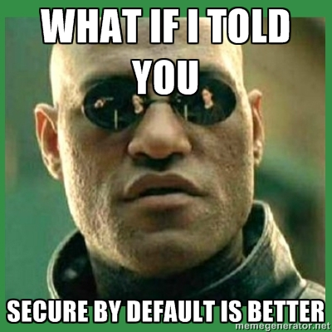
The Power of Default Security
Construct development frameworks that are secure by default
Minimizes work for developers
Will lower number of vulns.

Slide 108
Critical Success Factors
Get initiative buy-in from stakeholders
Adopt a risk-based approach
Awareness / education is the foundation
Integrate & automate security in your development / acquisition and deployment processes
Measure: Provide management visibility

Slide 109
Conclusions
Developing secure software gets more and more complex
OWASP SAMM2 = global maturity foundation for software assurance, in line with current trends and practices
Applying OWASP SAMM =
Assessment
Roadmap
(Continuous) Implementation
Be ready to face the organisational challenges that will pop up during the journey

Slide 110
SDLC Cornerstones (recap)
Process
Activities
Control Gates
Knowledge
Standards & Guidelines
Tools & Components
Deliverables
Transfer methods
People
Roles & Responsibilities
Compliance
Development support
Assessment tools
Management tools
Risk
Training
SecAppDev 2013
Notes:
110

Slide 111
Current roadmap
V2.0: end of 2019
2020:
v2.1, 2.2, ...: iterative releases
Agile/devops guidance
Roadshows/trainings

Slide 112
Looking forward
OWASP projects references
Online assessments, integrated with benchmark data
User community contributions
Support for regulations
SAMM user summits
Translations
...

Slide 113
Questions? Feedback? Input?
#project-samm
github.com/OWASP/samm

Slide 114
SAMM newsletter
eepurl.com/gl9fb9

Slide 115
Credits
Bart De Win – Project Co-Leader, Belgium
Sebastien (Seba) Deleersnyder – Project Co-Leader, Belgium
Brian Glass – United States
Daniel Kefer – Germany
Yan Kravchenko – United States
Chris Cooper – United Kingdom
John DiLeo – New Zealand
Nessim Kisserli – Belgium
Patricia Duarte - Uruguay
John Kennedy - Sweden
Hardik Parekh - United States
John Ellingsworth - United States
Sebastian Arriada - Argentina
Brett Crawley – United Kingdom
...

Slide 116



Thank You to Our Sponsors
Notes:
Thank you to our Sponsors. There are more Sponsorship opportunities still available! Please contact us if you would like to be a project sponsor.

Slide 117
SUPPORT OWASP SAMM
Software powers the world,
but insecure software threatens safety, trust, and economic growth.

Slide 118
Call for sponsors
All proceeds from the sponsorship support the mission of the OWASP foundation and the further development of SAMM, funding
marketing & PR support
technical editing & UX support
website development and hosting
SAMM user summits
core team summits
I18N
tooling for the SAMM Benchmark project
info@owaspsamm.org

Slide 119

Questions or Feedback ?

Slide 120
Thank you
info@owaspsamm.org seba@owasp.org

